Slide 1
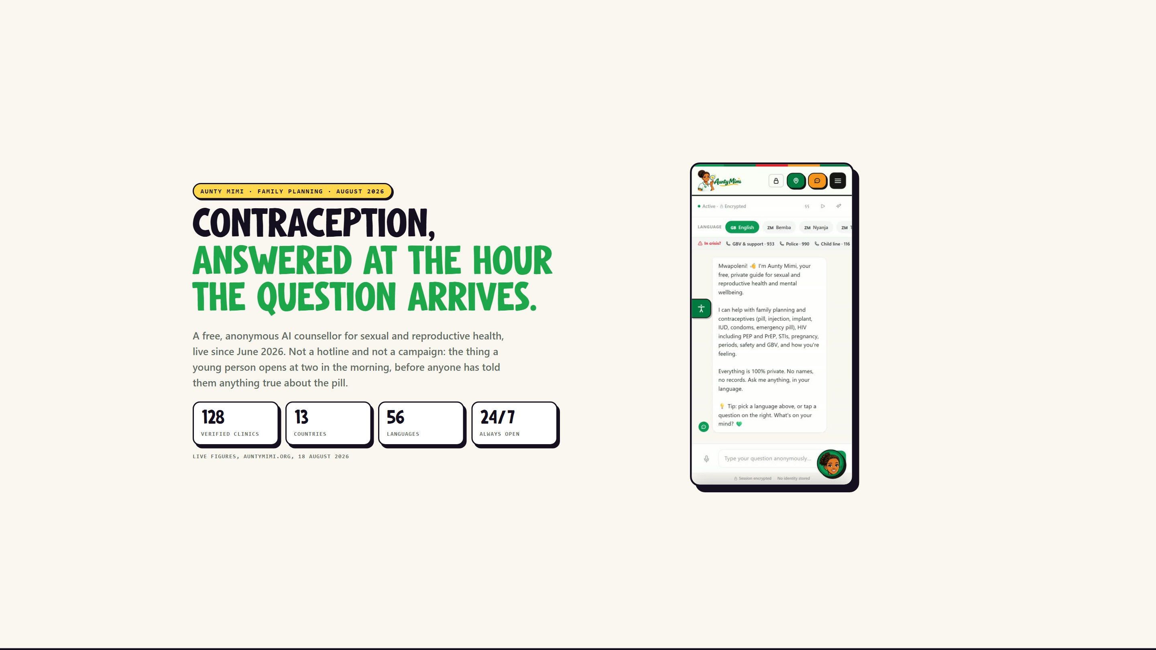
Notes:
Aunty Mimi - family planning - August 2026
Contraception, answered at the hour the question arrives.

Slide 2
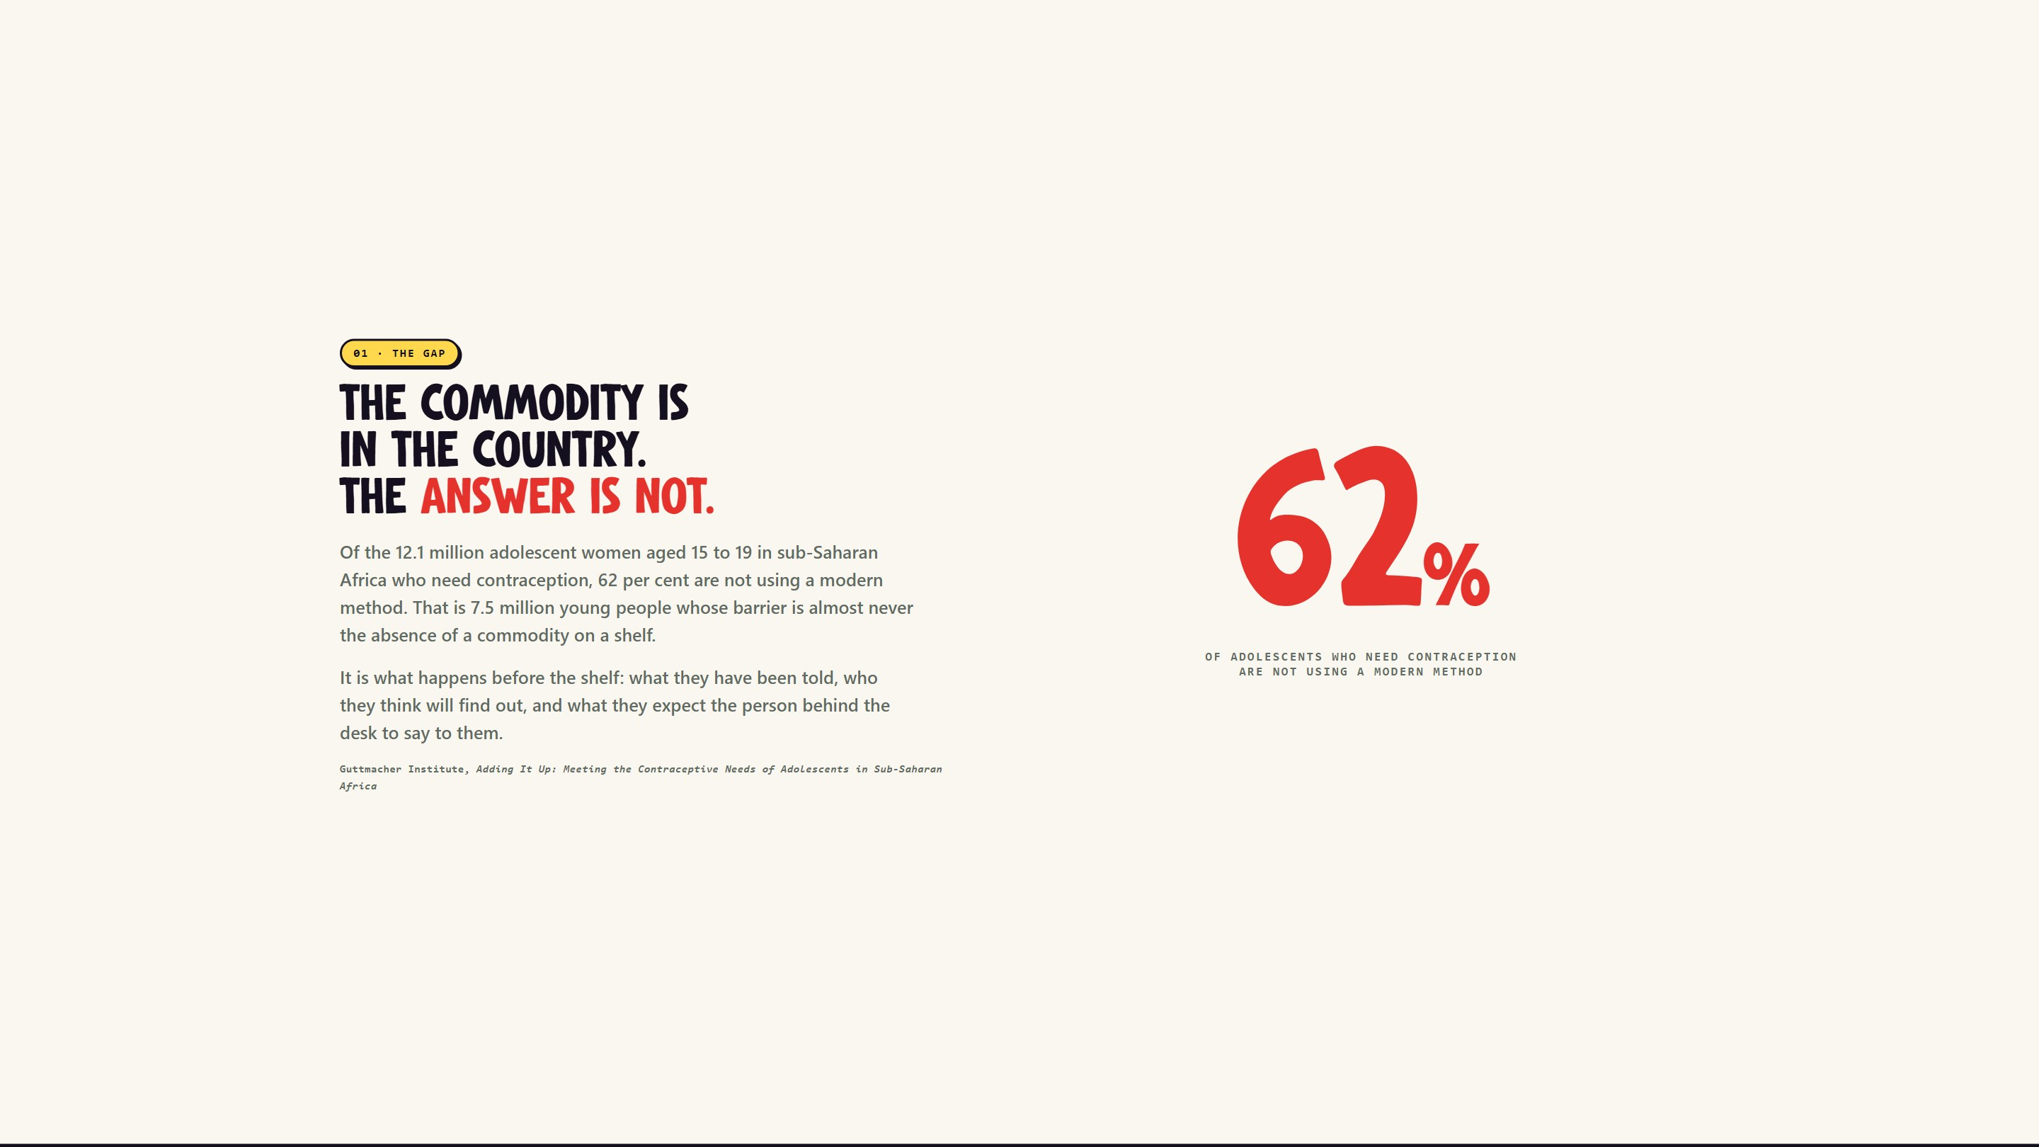
Notes:
01 - The gap
The commodity is in the country. The answer is not.

Slide 3
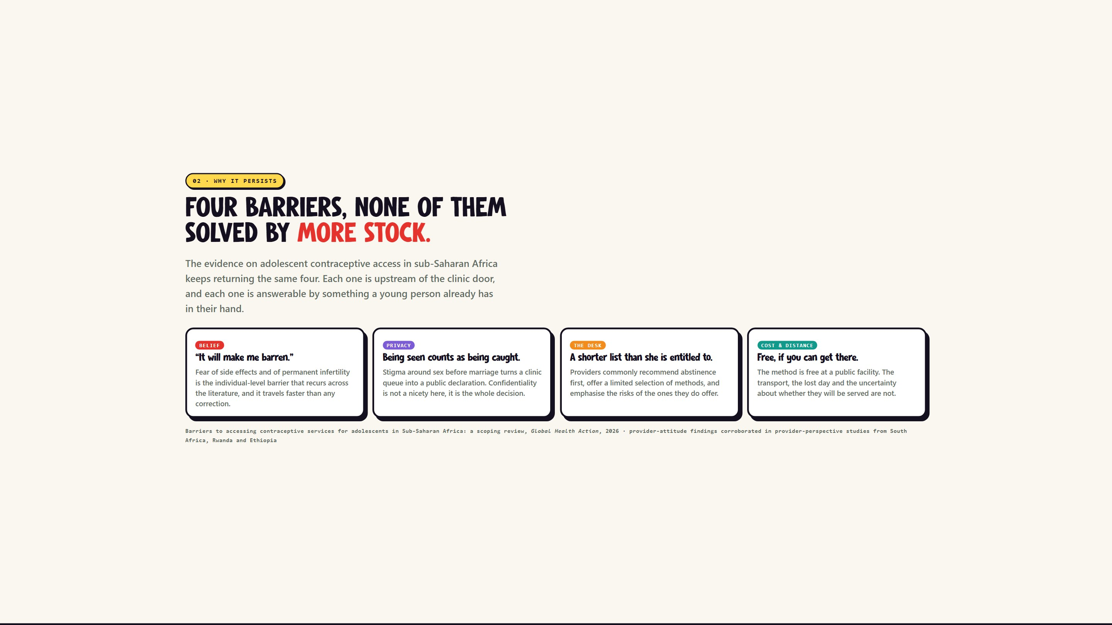
Notes:
02 - Why it persists
Four barriers, none of them solved by more stock.

Slide 4
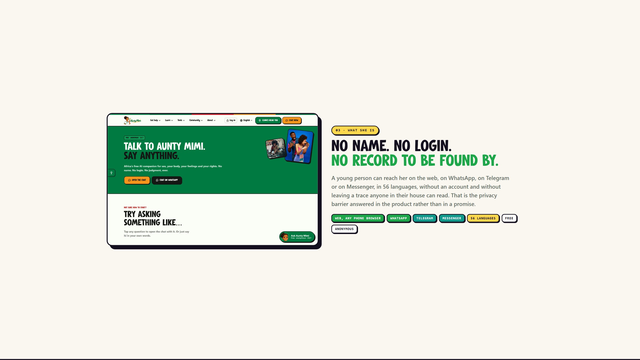
Notes:
03 - What she is
No name. No login. No record to be found by.

Slide 5
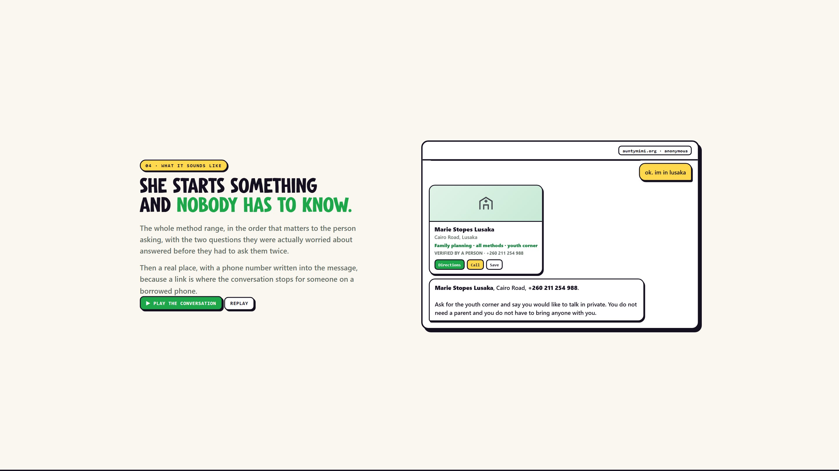
Notes:
04 - What it sounds like
She starts something and nobody has to know.

Slide 6
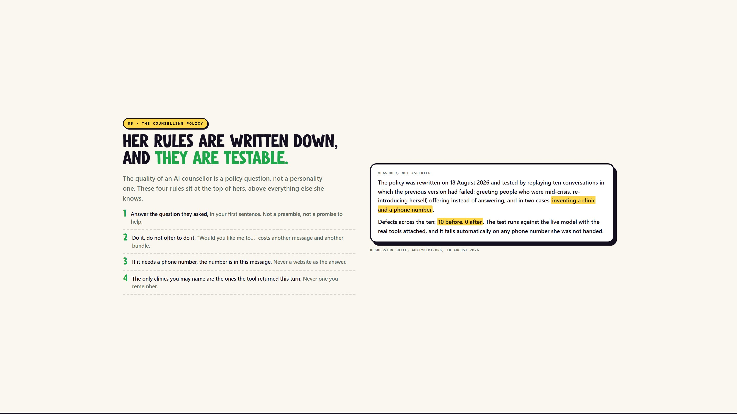
Notes:
05 - The counselling policy
Her rules are written down, and they are testable.

Slide 7
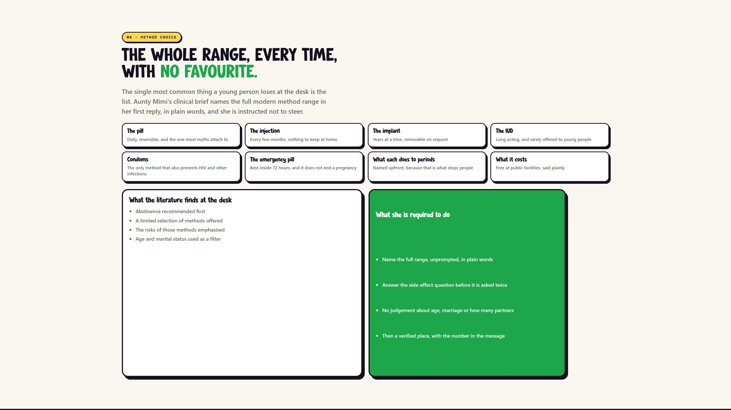
Notes:
06 - Method choice
The whole range, every time, with no favourite.

Slide 8
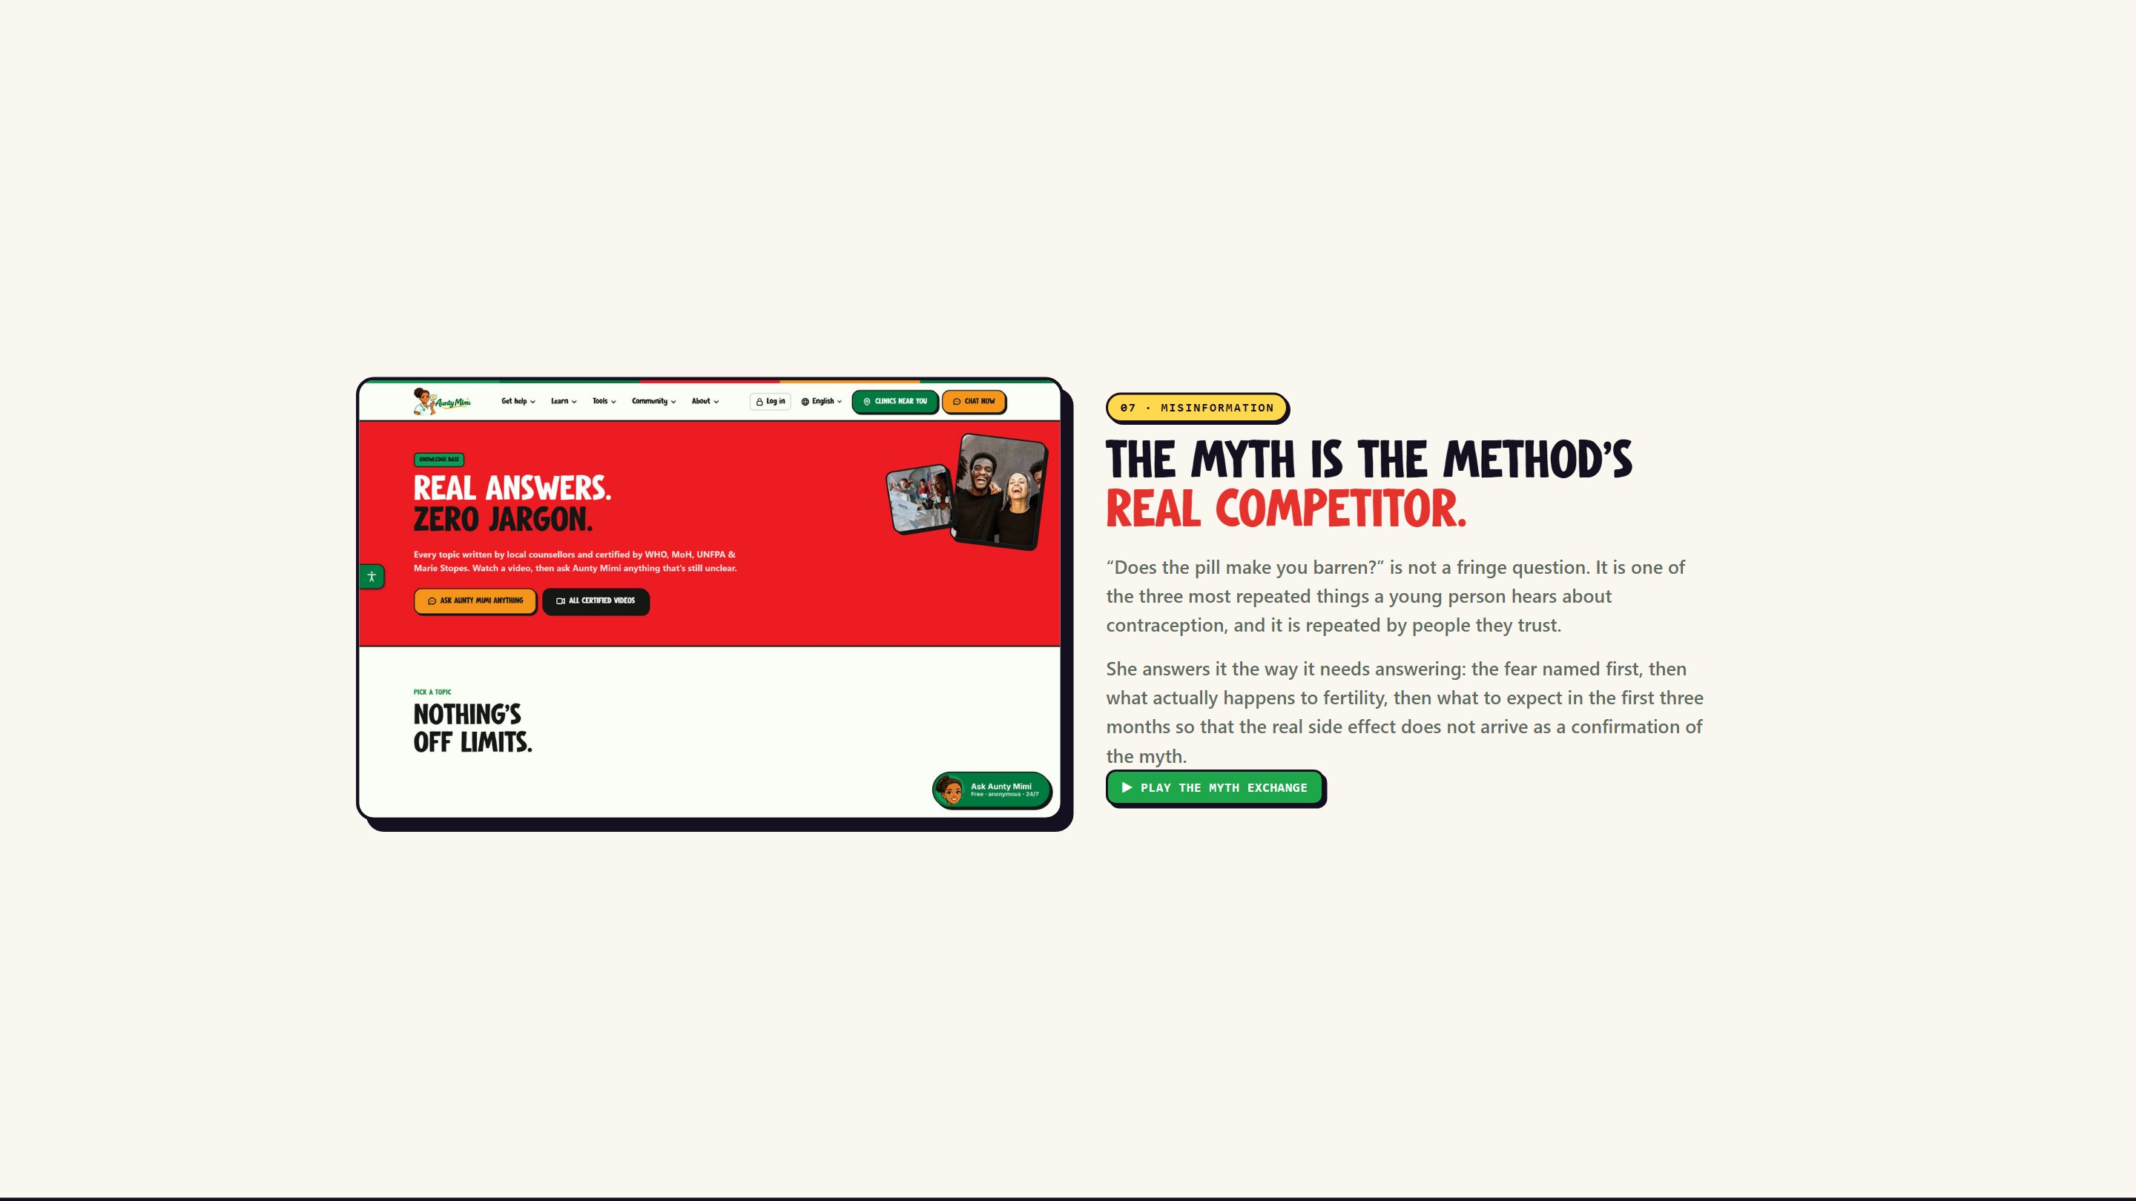
Notes:
07 - Misinformation
The myth is the method's real competitor.

Slide 9
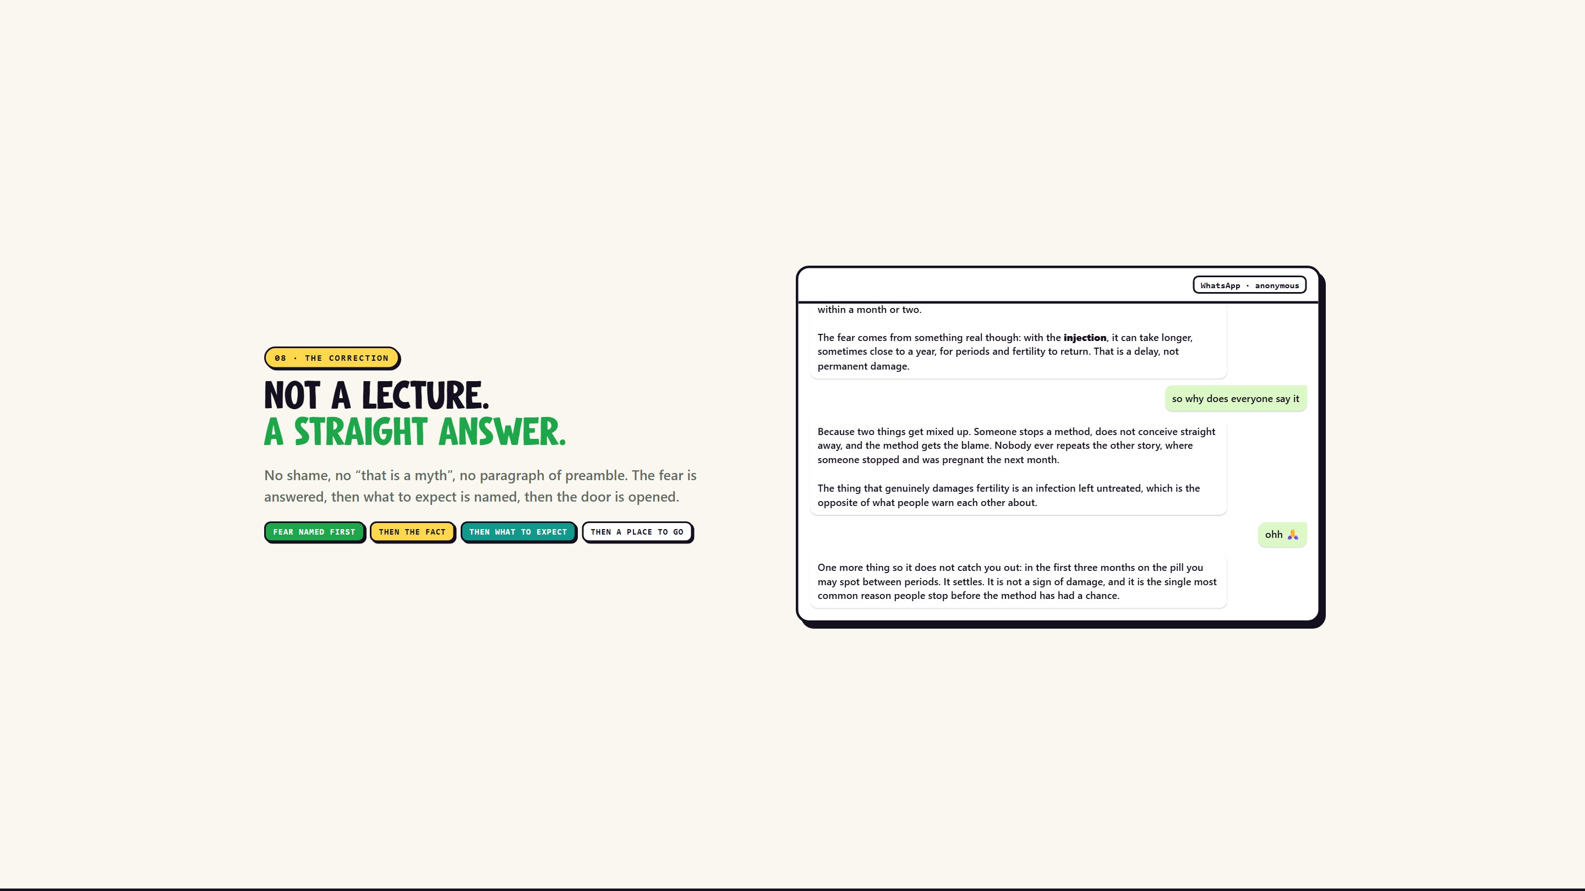
Notes:
08 - The correction
Not a lecture. A straight answer.

Slide 10
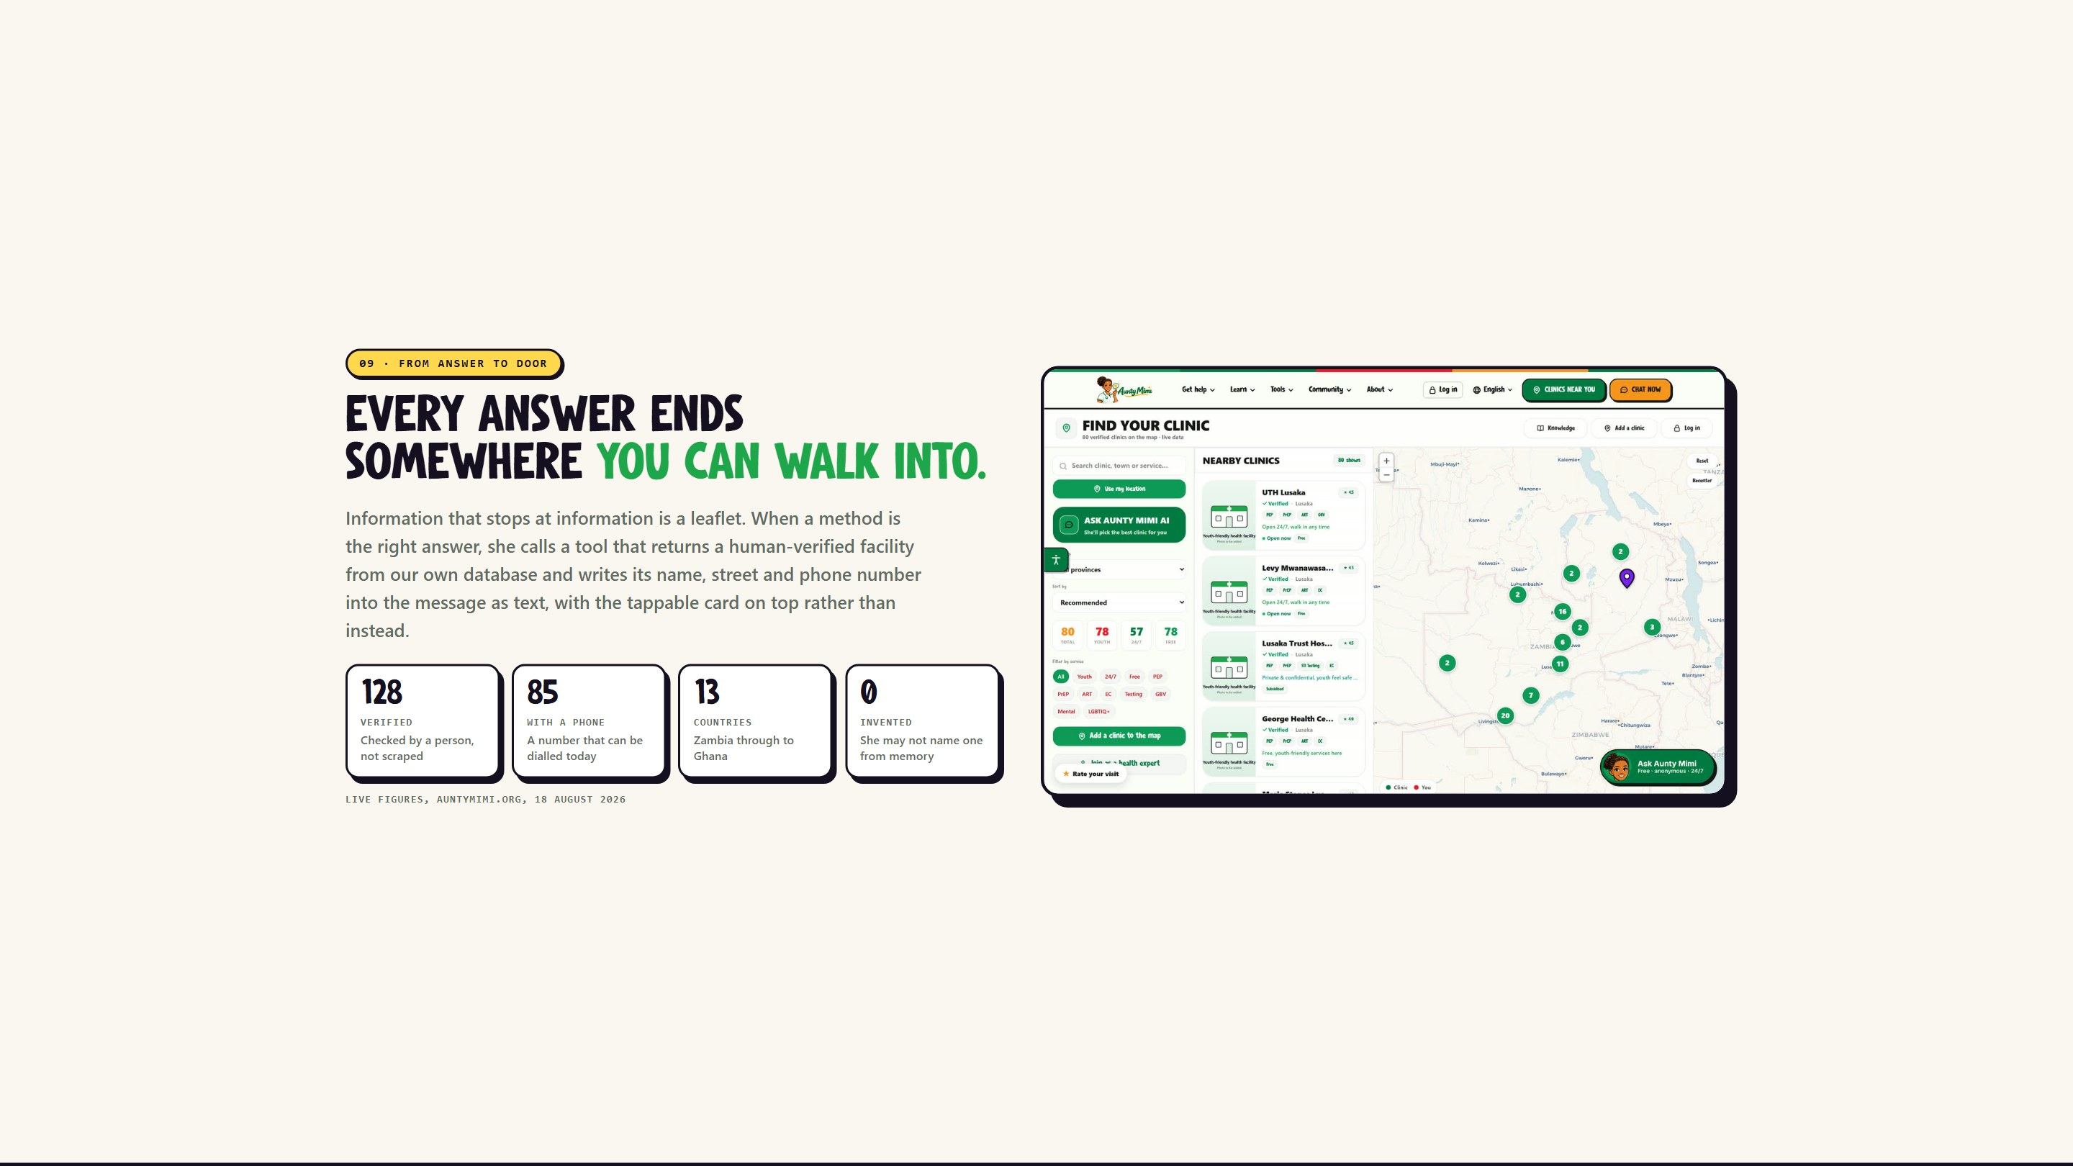
Notes:
09 - From answer to door
Every answer ends somewhere you can walk into.

Slide 11
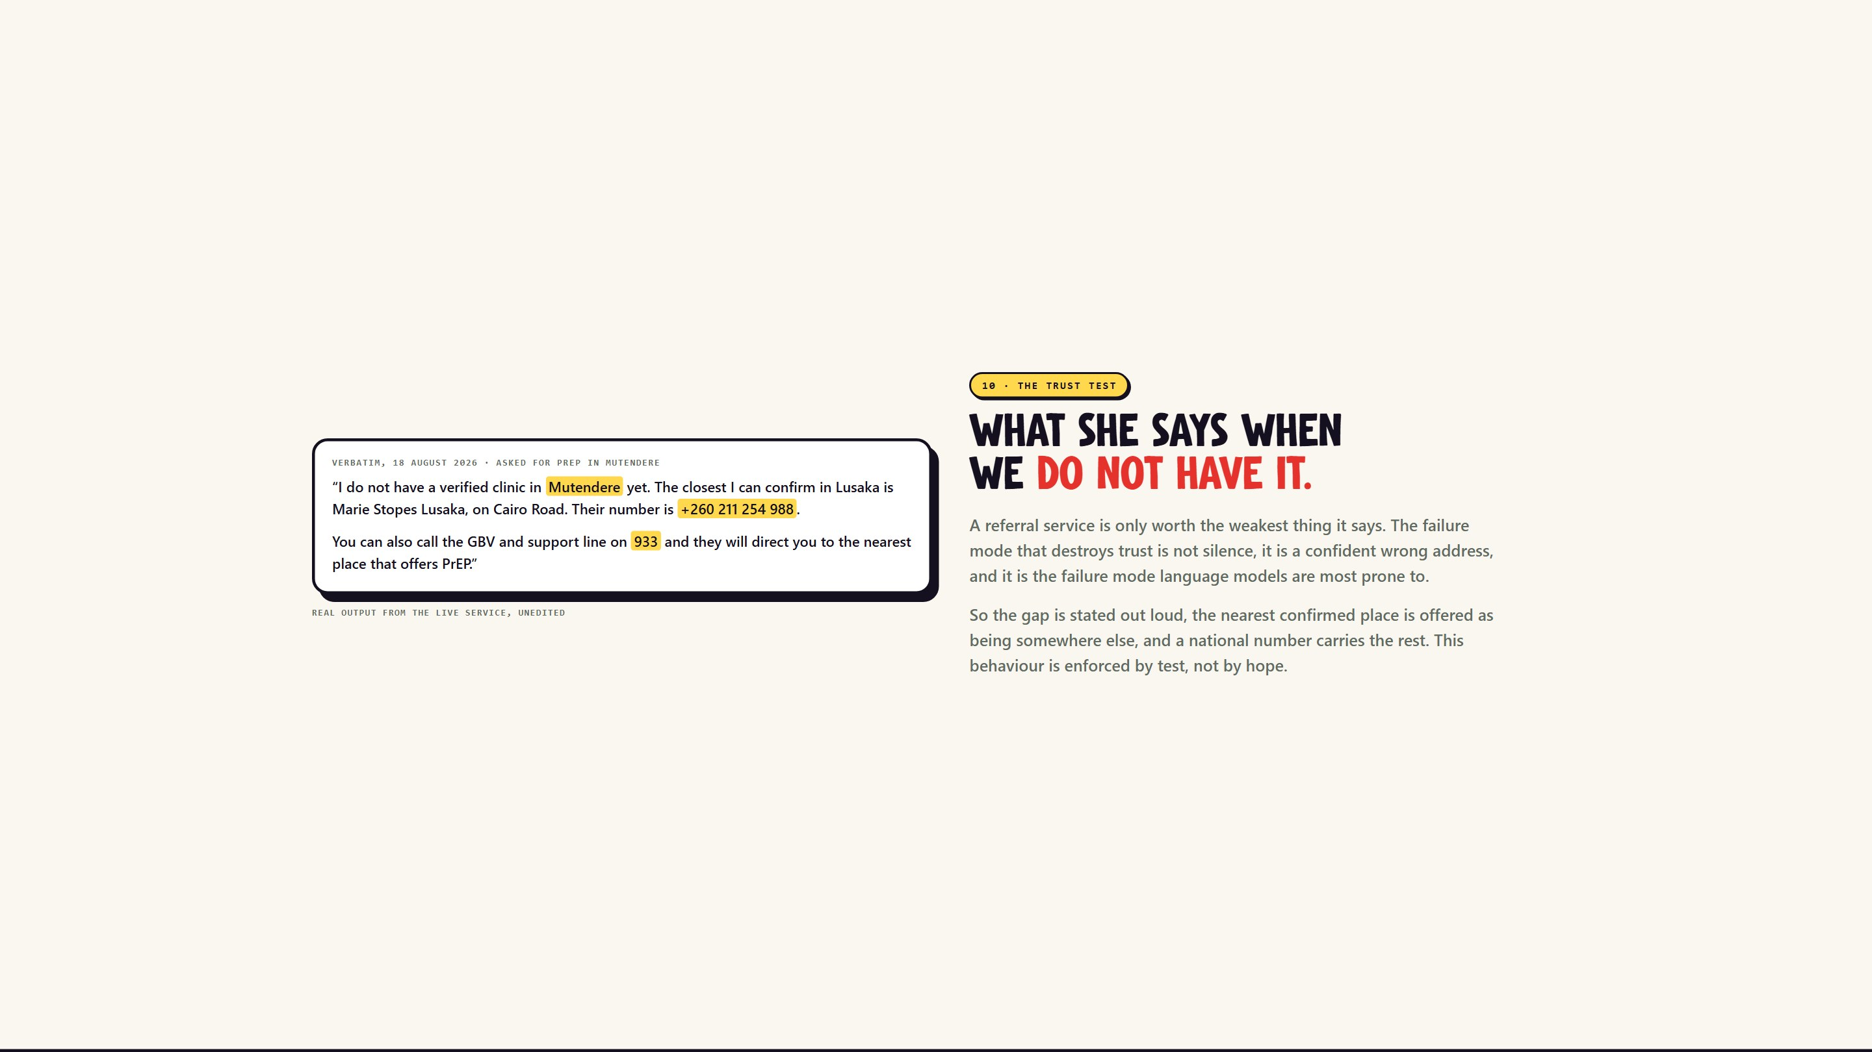
Notes:
10 - The trust test
What she says when we do not have it.

Slide 12
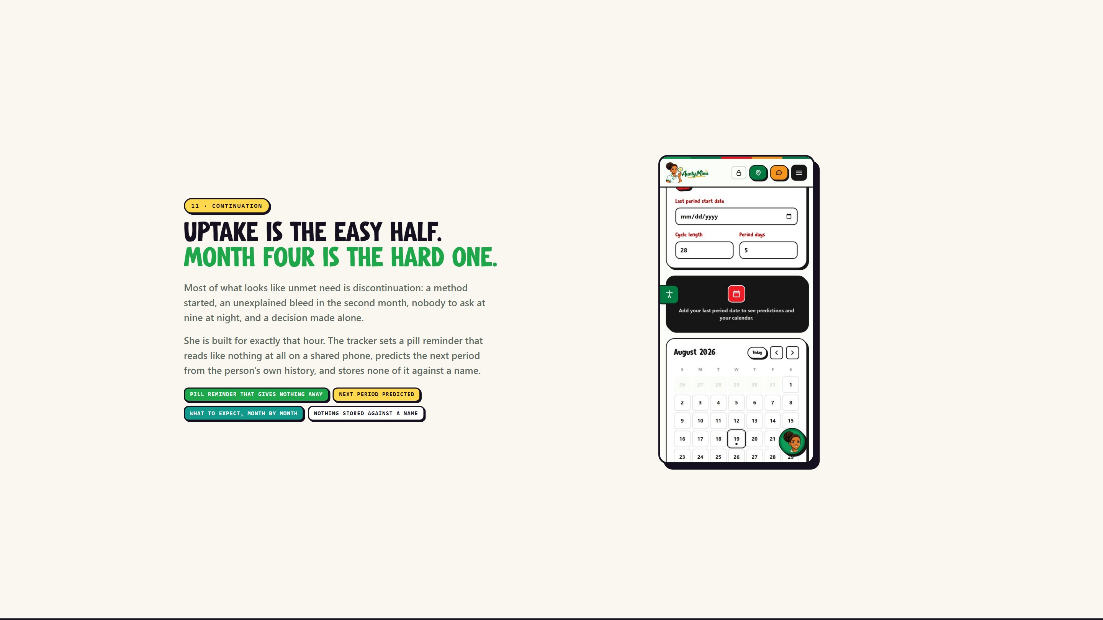
Notes:
11 - Continuation
Uptake is the easy half. Month four is the hard one.

Slide 13
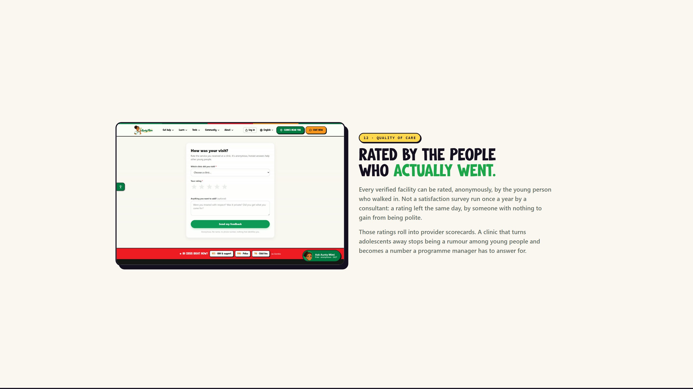
Notes:
12 - Quality of care
Rated by the people who actually went.

Slide 14
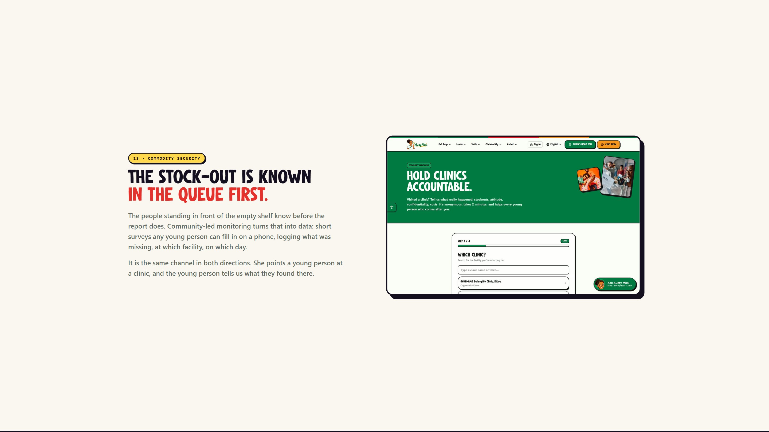
Notes:
13 - Commodity security
The stock-out is known in the queue first.

Slide 15

Notes:
14 - Who gets left out
Information you cannot read is not information.

Slide 16
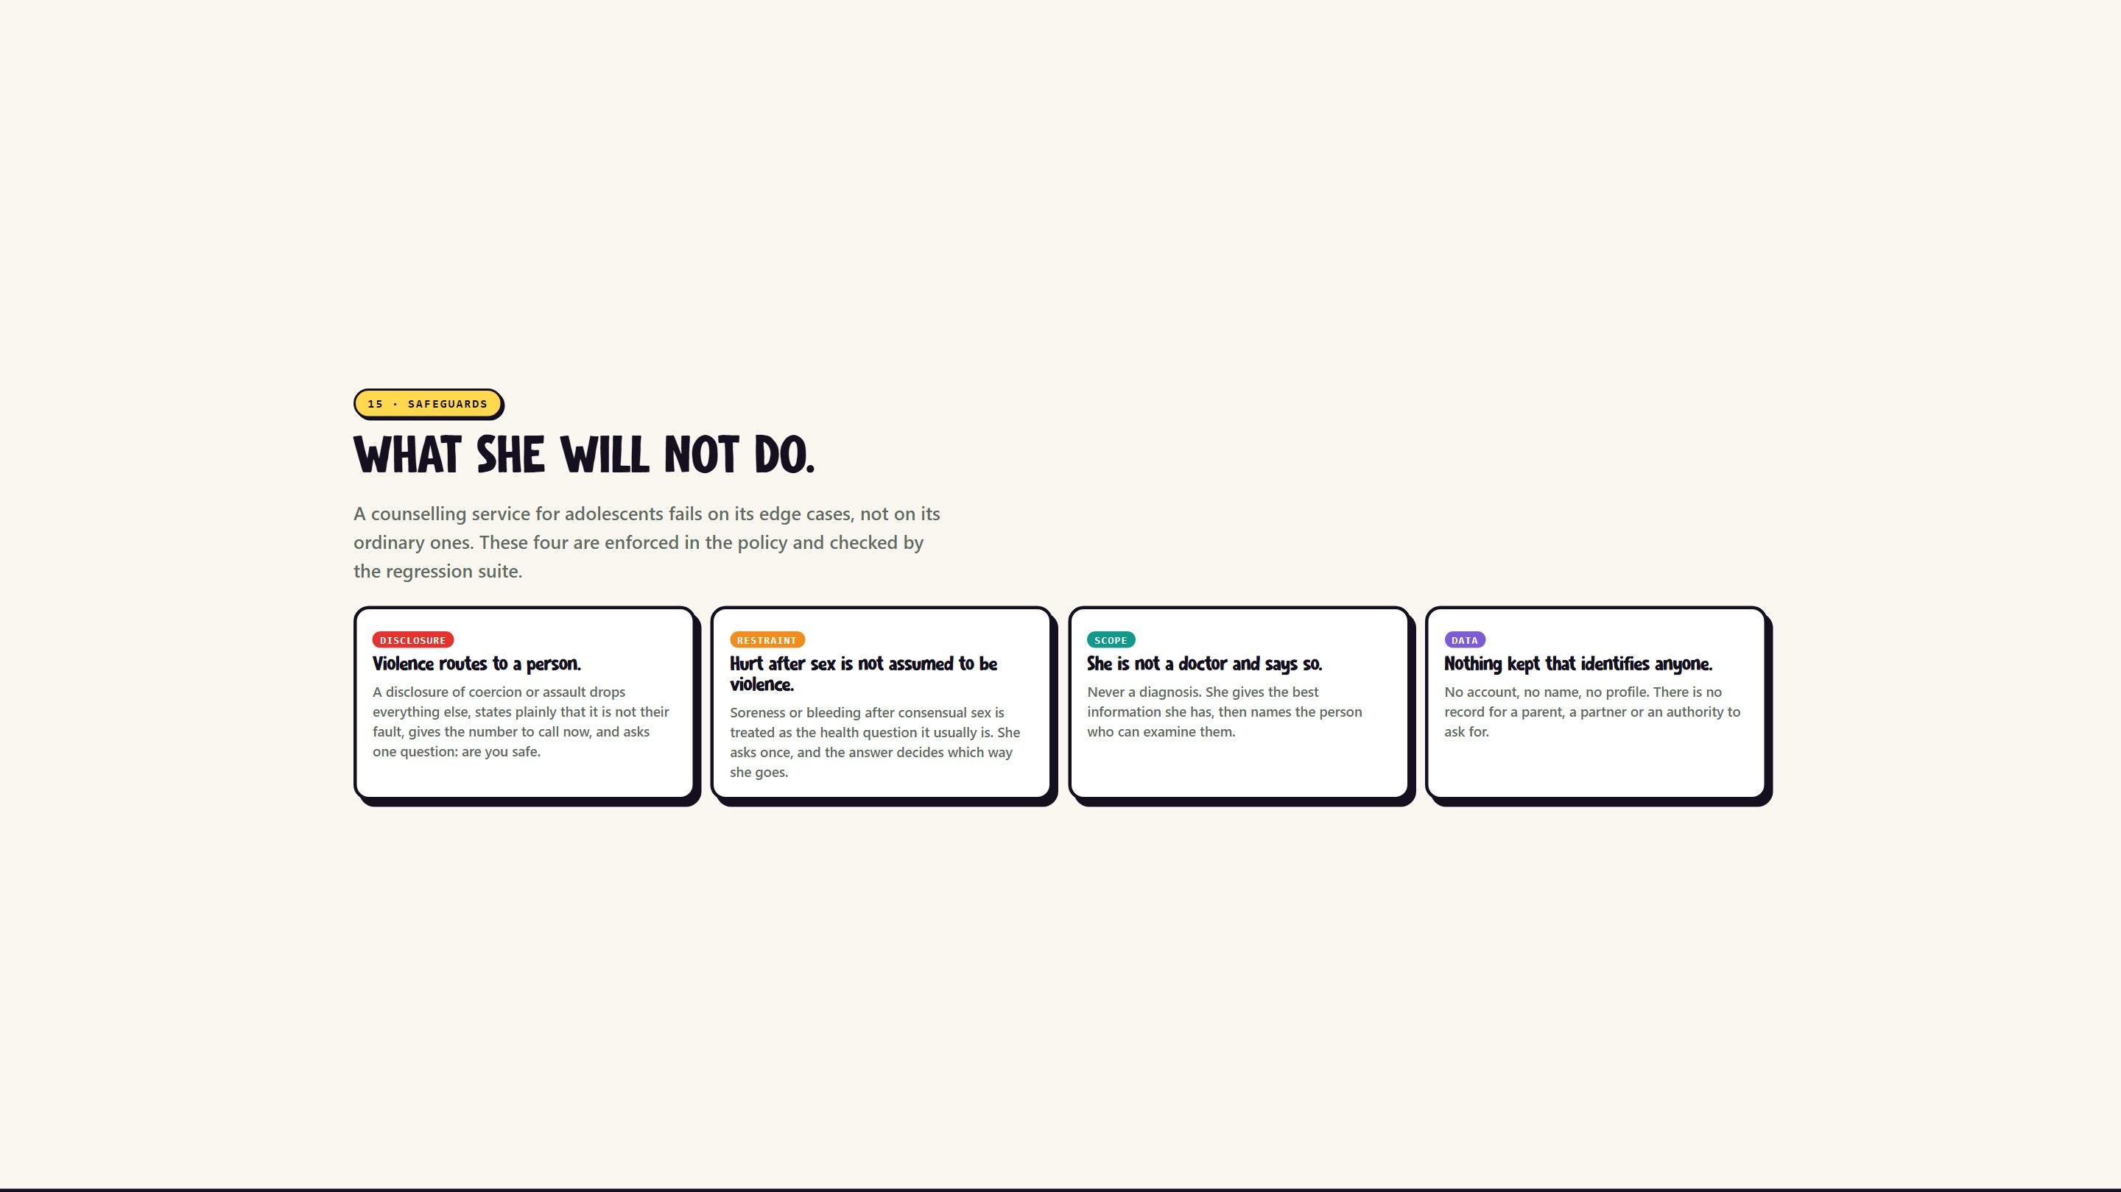
Notes:
15 - Safeguards
What she will not do.

Slide 17
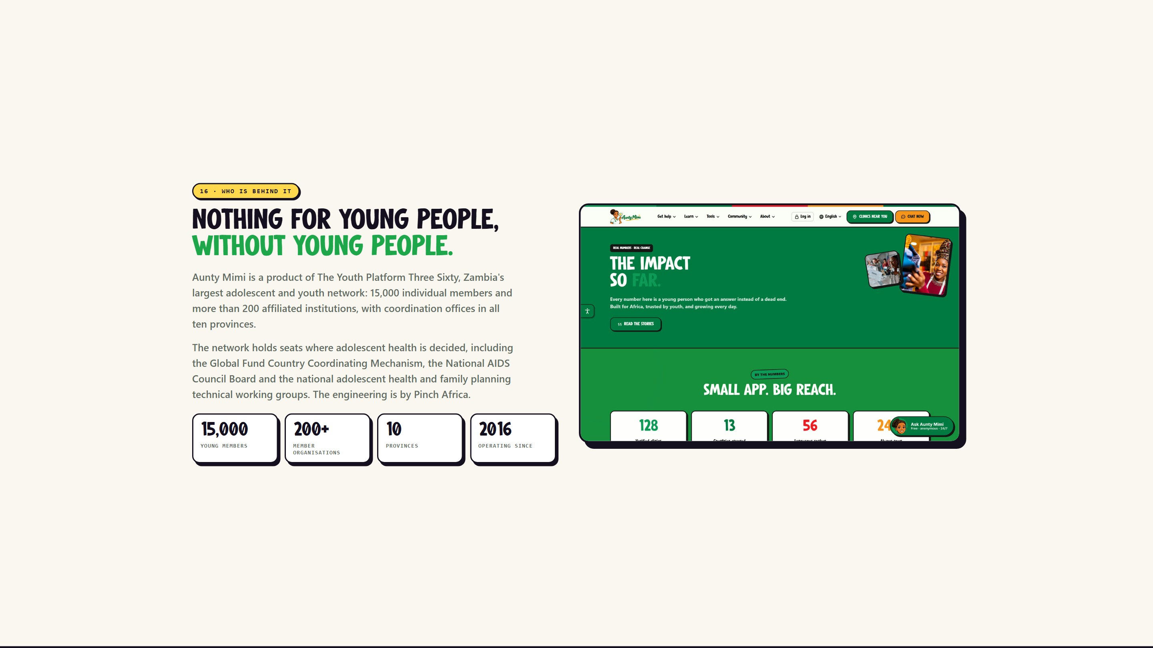
Notes:
16 - Who is behind it
Nothing for young people, without young people.

Slide 18

Notes:
17 - What comes out
Every claim in this deck came from a query.

Slide 19
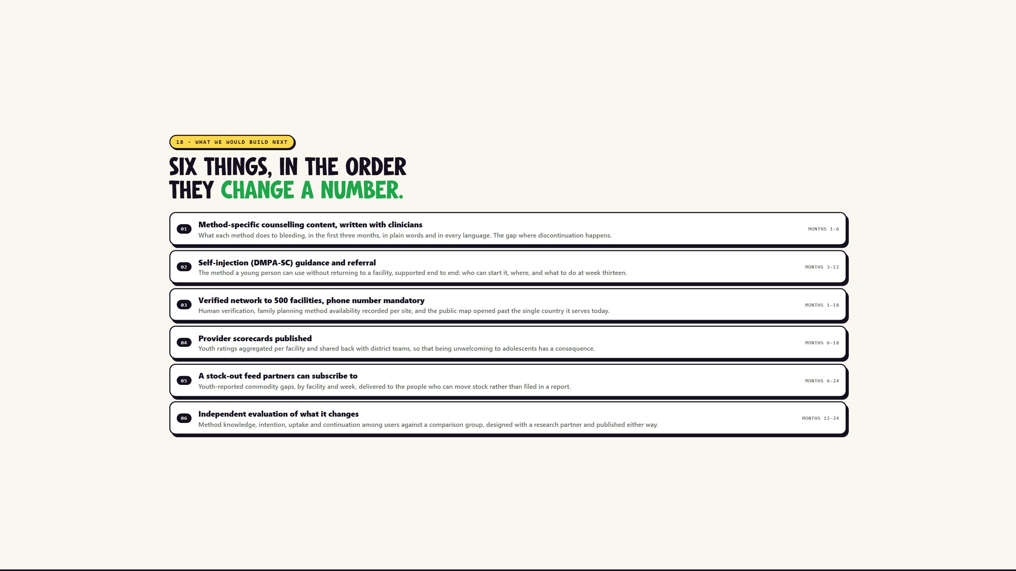
Notes:
18 - What we would build next
Six things, in the order they change a number.

Slide 20
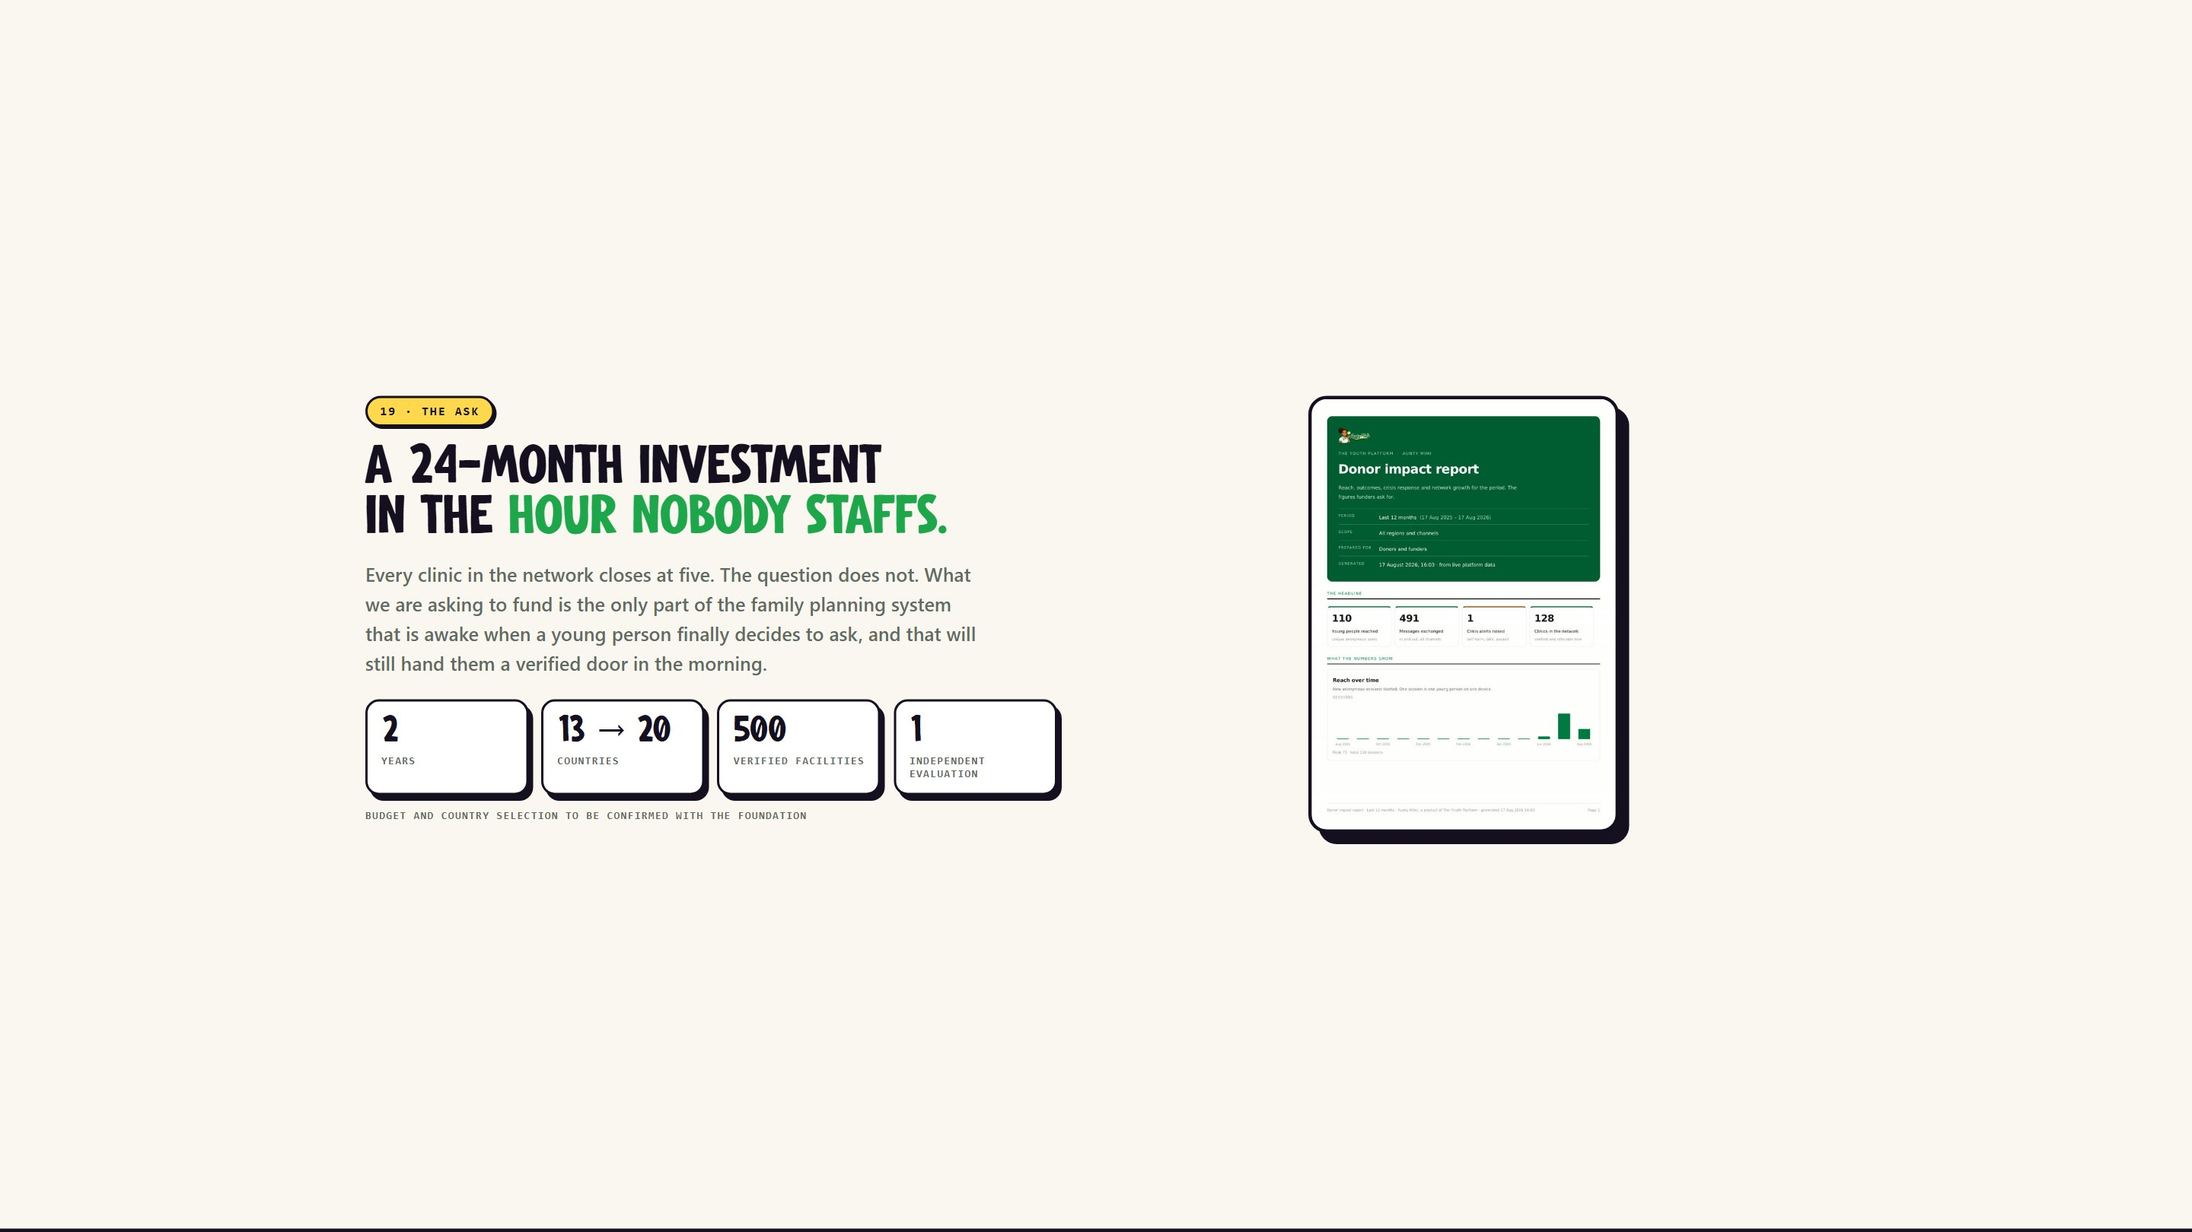
Notes:
19 - The ask
A 24-month investment in the hour nobody staffs.

Slide 21

Notes:
Slide 21
She is already awake. She just needs the range, and the map, to be bigger.

